Slide 1
Community Structure
Modularity Maximiztion, Spectral Modularity
MA 653: Network Science
Instructor: Ashok Singh Sairam
ashok@iitg.ac.in

Slide 2
Applications
So far, we have focused on measurements and models of network
provide a solid foundation for understanding
Apply what we have learned to gain insight into function of networked systems
Community detection
Studies of network failure and resilience
Epidemic and other spreading process

Slide 3
Ex: Network of coauthorships in a department

Slide 4
Dividing network into groups
Graph partitioning and community detection refer to the division of the vertices in a graph based on the connection patterns of the edges
The most common approach is to divide vertices in groups, such that the majority of edges connect members from the same group
Discovering communities in a network can be useful for revealing structure and organization in a network beyond the scale of a single vertex
Allows us to study large networks and break them up into smaller subsets that can be studied separately, for example for visulaizaton
Simplified representation of large networks

Slide 5
Number of groups
Depending on whether we have specified the number of groups we want to divide our network in, we have two different problems:
Graph partitioning: Minimum interaction between partitions
Community detection: Discover densely connected regions
Even though the general problem is the same, there are different algorithms that deal with each one of the problems

Slide 6
Graph partitioning
In graph partitioning the number of groups k is pre-defined
In particular, we want to divide the network vertices into k non-overlapping groups of given sizes such that the number of edges across groups are minimized
Sizes can also be provided in approximation only
E.g., within specific range
E.g., divide the network nodes into two groups of equal size, such that the number of edges between them is minimized
Graph partitioning is useful in parallel processing of numerical solutions of network processes

Slide 7
Community detection
In community detection neither the number of groups nor their sizes are pre-defined
The goal is to find the natural fault lines along which the network separates
Few edges between groups and many edges within groups
Community detection is not as well-posed of a problem as graph partitioning
What do we mean “many” and “few”?
Many different objectives → different algorithms

Slide 8
Problem formulation
Formulate the problem of community detection as a maximization prob.
Consider a simple, undirected network
Divide the network into every possible division
Assign high score if division is “good” (division has many edges within communities),
Assign low score if division is “bad”.
Search through the divisions to find the one with the highest score

Slide 9
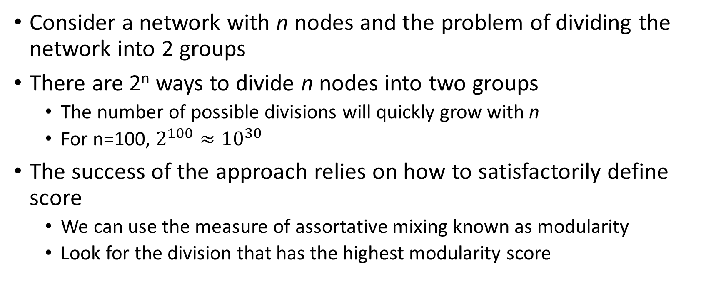
A brute force approach
Consider a network with n nodes and the problem of dividing the network into 2 groups
There are 2^{n} ways to divide n nodes into two groups
The number of possible divisions will quickly grow with n
For n=100, $2^{100}≈{10}^{30}$
The success of the approach relies on how to satisfactorily define score
We can use the measure of assortative mixing known as modularity
Look for the division that has the highest modularity score

Slide 10
Assortative Mixing and Community detection
Nodes with similar characteristics tend to be connected by edges
Modularity is a measure of assortative mixing
It has high value when connections are b/w nodes of same type
We can think of good divisions as ones with high modularity score
Thus one way to detect community is to find divisions with highest modularity score

Slide 11
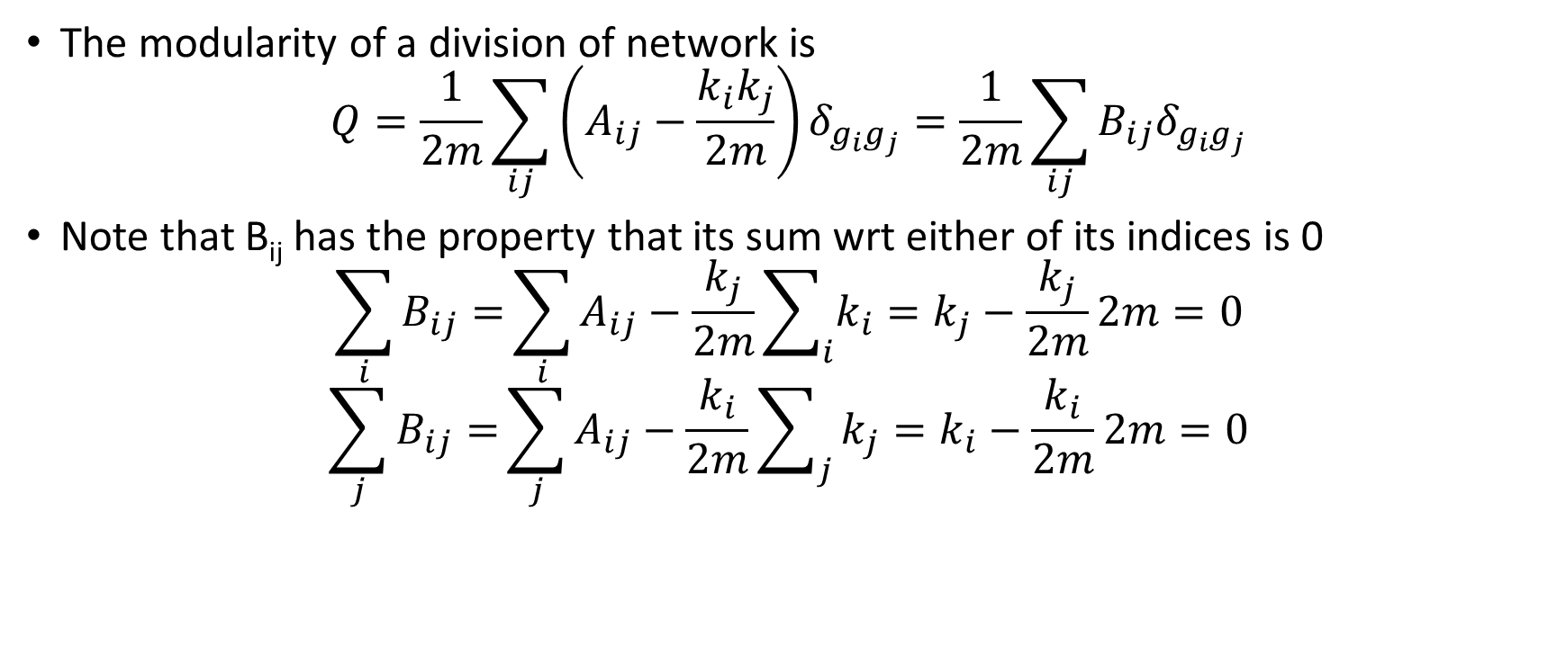
Form of the Modularity function
The modularity of a division of network is
$$Q=\frac{1}{2m}\sum_{ij}{\left(A_{ij}−\frac{k_{i}k_{j}}{2m}\right)δ_{g_{i}g_{j}}}=\frac{1}{2m}\sum_{ij}{B_{ij}δ_{g_{i}g_{j}}}$$
Note that B_{ij} has the property that its sum wrt either of its indices is 0
$$\sum_{i}{B_{ij}=}\sum_{i}{A_{ij}−\frac{k_{j}}{2m}\sum_{i}{k_{i}}=k_{j}−\frac{k_{j}}{2m}2m}=0$$
$$\sum_{j}{B_{ij}=}\sum_{j}{A_{ij}−\frac{k_{i}}{2m}\sum_{j}{k_{j}}=k_{i}−\frac{k_{i}}{2m}2m}=0$$

Slide 12
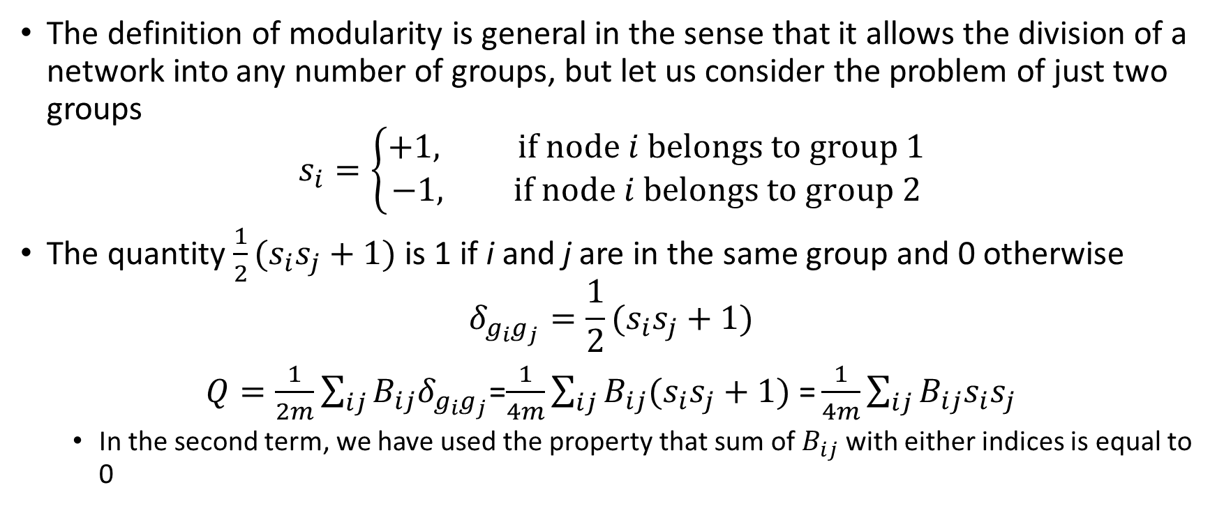
The definition of modularity is general in the sense that it allows the division of a network into any number of groups, but let us consider the problem of just two groups
$$s_{i}=\left\{\begin{aligned}+1, if node i belongs to group 1 \\ −1, if node i belongs to group 2\end{aligned}\right.$$
The quantity $\frac{1}{2}(s_{i}s_{j}+1)$ is 1 if i and j are in the same group and 0 otherwise
$$δ_{g_{i}g_{j}}=\frac{1}{2}(s_{i}s_{j}+1)$$
$Q=\frac{1}{2m}\sum_{ij}{B_{ij}δ_{g_{i}g_{j}}}$=$\frac{1}{4m}\sum_{ij}{B_{ij}(s_{i}s_{j}+1) \text{=}}\frac{1}{4m}\sum_{ij}{B_{ij}s_{i}s_{j}}$
In the second term, we have used the property that sum of $B_{ij}$ with either indices is equal to 0

Slide 13
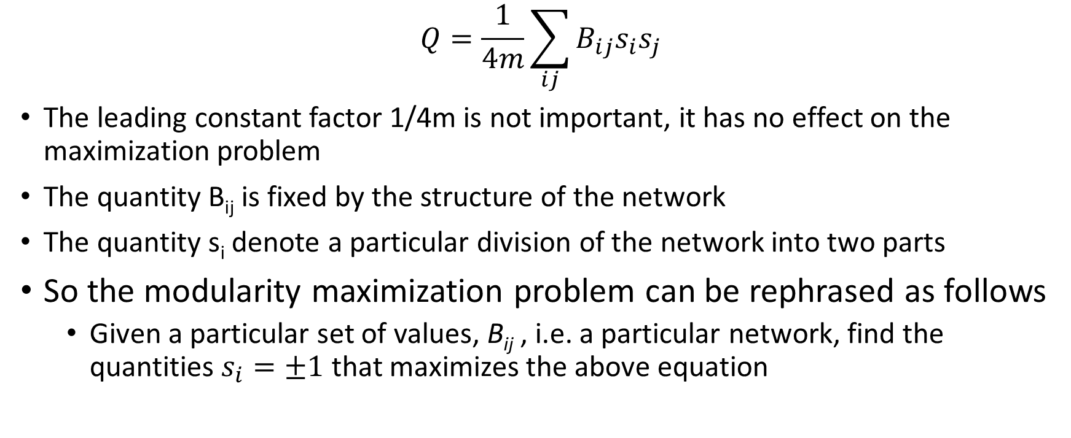
Problem formulation: Modularity maximization
$$Q=\frac{1}{4m}\sum_{ij}{B_{ij}s_{i}s_{j}}$$
The leading constant factor 1/4m is not important, it has no effect on the maximization problem
The quantity B_{ij} is fixed by the structure of the network
The quantity s_{i} denote a particular division of the network into two parts
So the modularity maximization problem can be rephrased as follows
Given a particular set of values, B_{ij} , i.e. a particular network, find the quantities $s_{i}=±1$ that maximizes the above equation

Slide 14
Approaches to Modularity Maximization
This problem falls in the generic class of discrete optimization problems, we are maximizing a known function of a set of discrete-valued variables
There are general computational methods available for finding solution to such problems
This solutions give approximate results. The approximations are acceptable as long as the methods basically finds the right division
However, if the modularity value is high but the division is not optimal, the solution is not acceptable.
Both the solutions are possible
The approximate detection method works well where the community structure leaps out

Slide 15
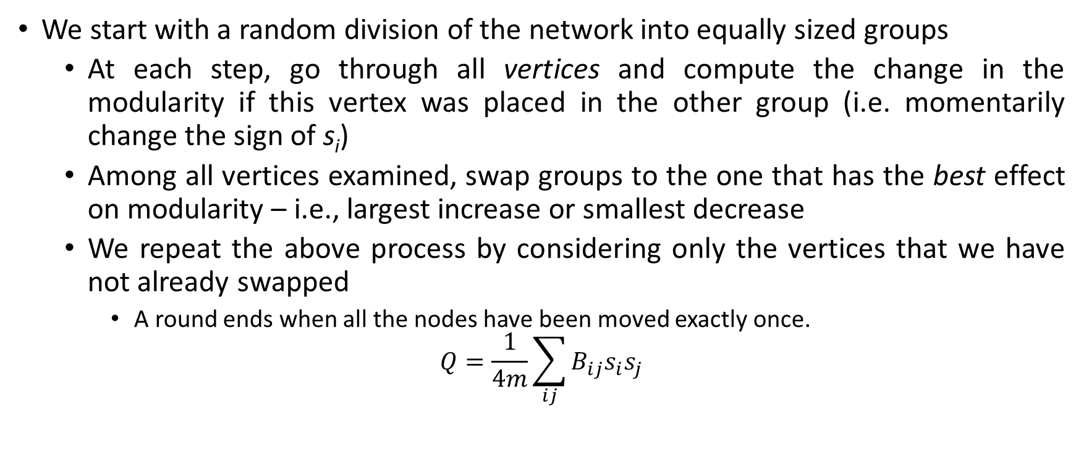
Simple Modularity Maximization
We start with a random division of the network into equally sized groups
At each step, go through all vertices and compute the change in the modularity if this vertex was placed in the other group (i.e. momentarily change the sign of s_{i})
Among all vertices examined, swap groups to the one that has the best effect on modularity – i.e., largest increase or smallest decrease
We repeat the above process by considering only the vertices that we have not already swapped
A round ends when all the nodes have been moved exactly once.
$$Q=\frac{1}{4m}\sum_{ij}{B_{ij}s_{i}s_{j}}$$

Slide 16
After we go through all vertices, we go through all the states of the network and keep the one with the higher modularity
We repeat the whole process starting with the best network that we identified in the previous round until the modularity no longer improves
What is the time complexity of this algorithm ?

Slide 17
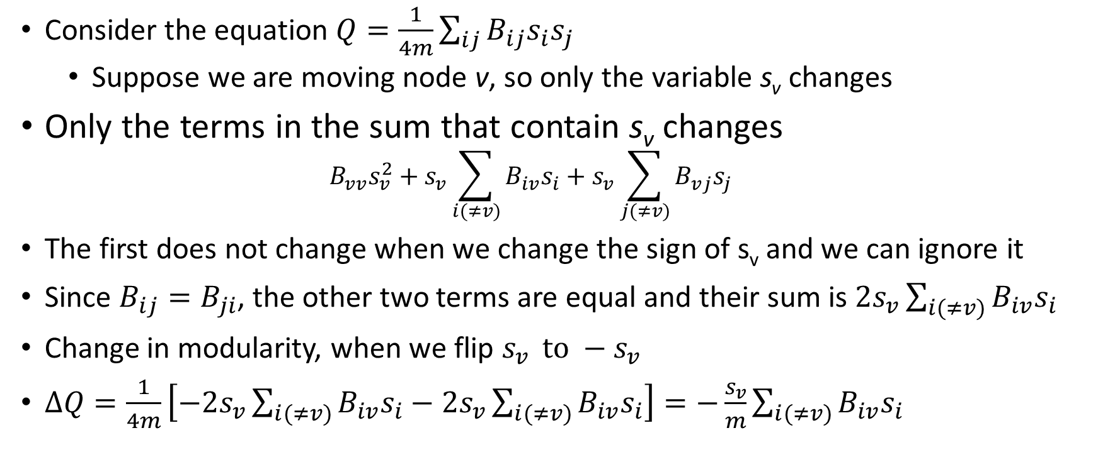
Simple Modularity Maximization: Time complexity
Consider the equation $Q=\frac{1}{4m}\sum_{ij}{B_{ij}s_{i}s_{j}}$
Suppose we are moving node v, so only the variable s_{v} changes
Only the terms in the sum that contain s_{v} changes
$$B_{vv}s_{v}^{2}+s_{v}\sum_{i(≠v)}{B_{iv}s_{i}+s_{v}\sum_{j(≠v)}{B_{vj}s_{j}}}$$
The first does not change when we change the sign of s_{v} and we can ignore it
Since $B_{ij}=B_{ji}$, the other two terms are equal and their sum is ${2s}_{v}\sum_{i(≠v)}{B_{iv}s_{i}}$
Change in modularity, when we flip $s_{v } to −s_{v}$
$ΔQ=\frac{1}{4m}\left[−{2s}_{v}\sum_{i(≠v)}{B_{iv}s_{i}−{2s}_{v}\sum_{i(≠v)}{B_{iv}s_{i}}}\right]=−\frac{s_{v}}{m}\sum_{i(≠v)}{B_{iv}s_{i}}$

Slide 18
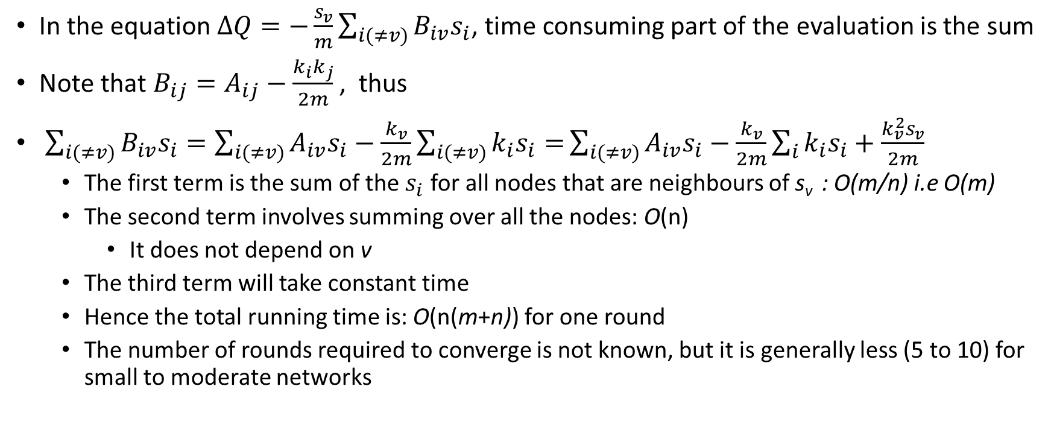
In the equation $ΔQ=−\frac{s_{v}}{m}\sum_{i(≠v)}{B_{iv}s_{i}}$, time consuming part of the evaluation is the sum
Note that $B_{ij}=A_{ij}−\frac{k_{i}k_{j}}{2m}$ , thus
$\sum_{i(≠v)}{B_{iv}s_{i}}=\sum_{i(≠v)}{A_{iv}s_{i}−\frac{k_{v}}{2m}\sum_{i(≠v)}{k_{i}s_{i}=}\sum_{i(≠v)}{A_{iv}s_{i}−\frac{k_{v}}{2m}}}\sum_{i}{k_{i}s_{i}+\frac{k_{v}^{2}s_{v}}{2m}}$
The first term is the sum of the $s_{i}$ for all nodes that are neighbours of s_{v} : O(m/n) i.e O(m)
The second term involves summing over all the nodes: O(n)
It does not depend on v
The third term will take constant time
Hence the total running time is: O(n(m+n)) for one round
The number of rounds required to converge is not known, but it is generally less (5 to 10) for small to moderate networks

Slide 19
Spectral Modularity Maximization
The simple modularity maximization works well but it is not the fastest approach
We will look at a more advanced “spectral” algorithm
Spectral graph theory uses the eigenvalues and eigenvectors of graph matrices, such as the adjacency matrix
Spectral here means the connection between the graph and spectral properties of the associated matrices

Slide 20
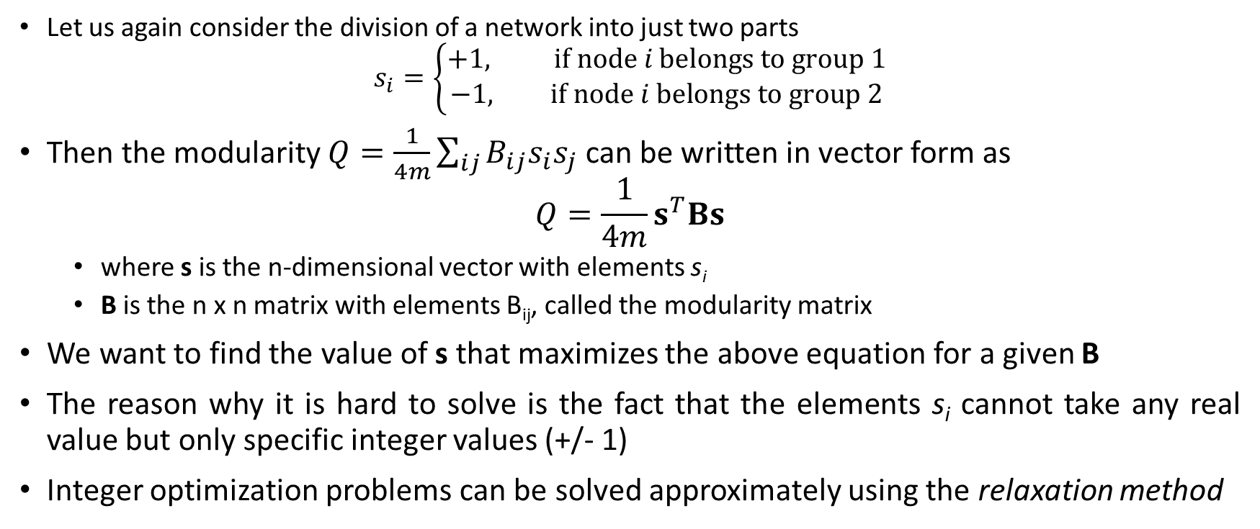
Spectral Modularity Maximization
Let us again consider the division of a network into just two parts
$$s_{i}=\left\{\begin{aligned}+1, if node i belongs to group 1 \\ −1, if node i belongs to group 2\end{aligned}\right.$$
Then the modularity $Q=\frac{1}{4m}\sum_{ij}{B_{ij}s_{i}s_{j}}$ can be written in vector form as
$$Q=\frac{1}{4m}s^{T}Bs$$
where s is the n-dimensional vector with elements s_{i}
B is the n x n matrix with elements B_{ij}, called the modularity matrix
We want to find the value of s that maximizes the above equation for a given B
The reason why it is hard to solve is the fact that the elements s_{i} cannot take any real value but only specific integer values (+/- 1)
Integer optimization problems can be solved approximately using the relaxation method

Slide 21
In the original integer problem the vector s would point to one of the 2^{n} corners of an n-dimensional hypercube centered at the origins
The length of this vector is
We relax the above constraint by allowing the vector s to point to any direction on a hypersphere circumscribing the original hypercube as long as its length is still

Slide 22

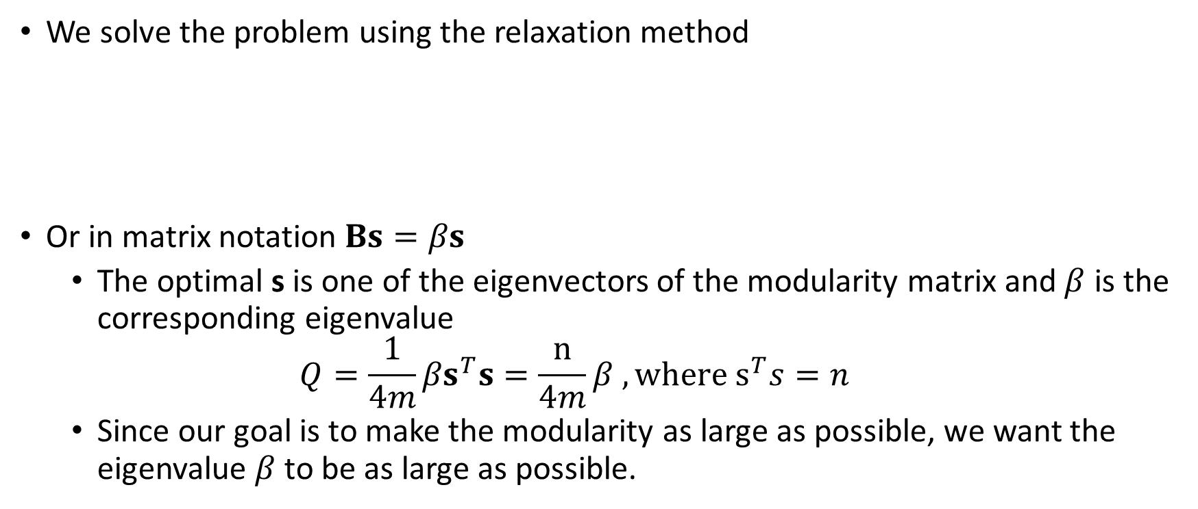
We solve the problem using the relaxation method
Or in matrix notation $Bs=βs$
The optimal s is one of the eigenvectors of the modularity matrix and $β$ is the corresponding eigenvalue
$$Q=\frac{1}{4m}{βs}^{T}s=\frac{n}{4m}β , where s^{T}s=n$$
Since our goal is to make the modularity as large as possible, we want the eigenvalue $β$ to be as large as possible.

Slide 23
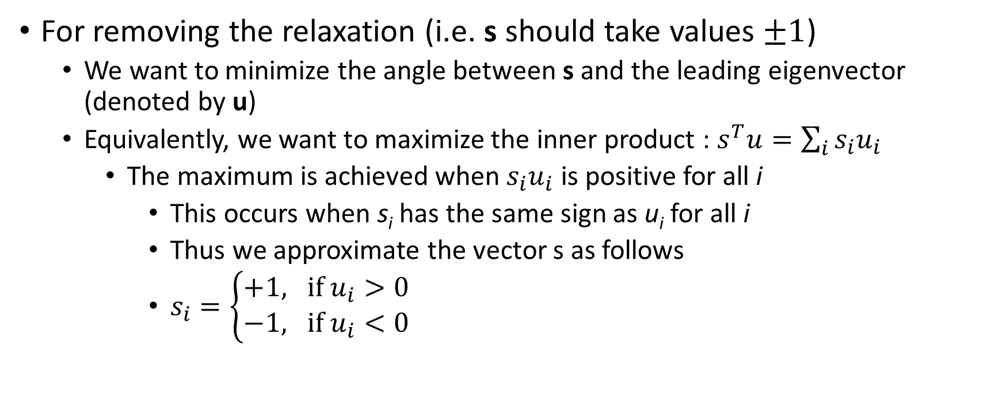
For removing the relaxation (i.e. s should take values $±1$)
We want to minimize the angle between s and the leading eigenvector (denoted by u)
Equivalently, we want to maximize the inner product : $s^{T}u=\sum_{i}{s_{i}u_{i}}$
The maximum is achieved when $s_{i}u_{i}$ is positive for all i
This occurs when s_{i} has the same sign as u_{i} for all i
Thus we approximate the vector s as follows
$s_{i}=\left\{\begin{aligned}+1, if u_{i}>0 \\ −1, if u_{i}<0\end{aligned}\right.$

Slide 24
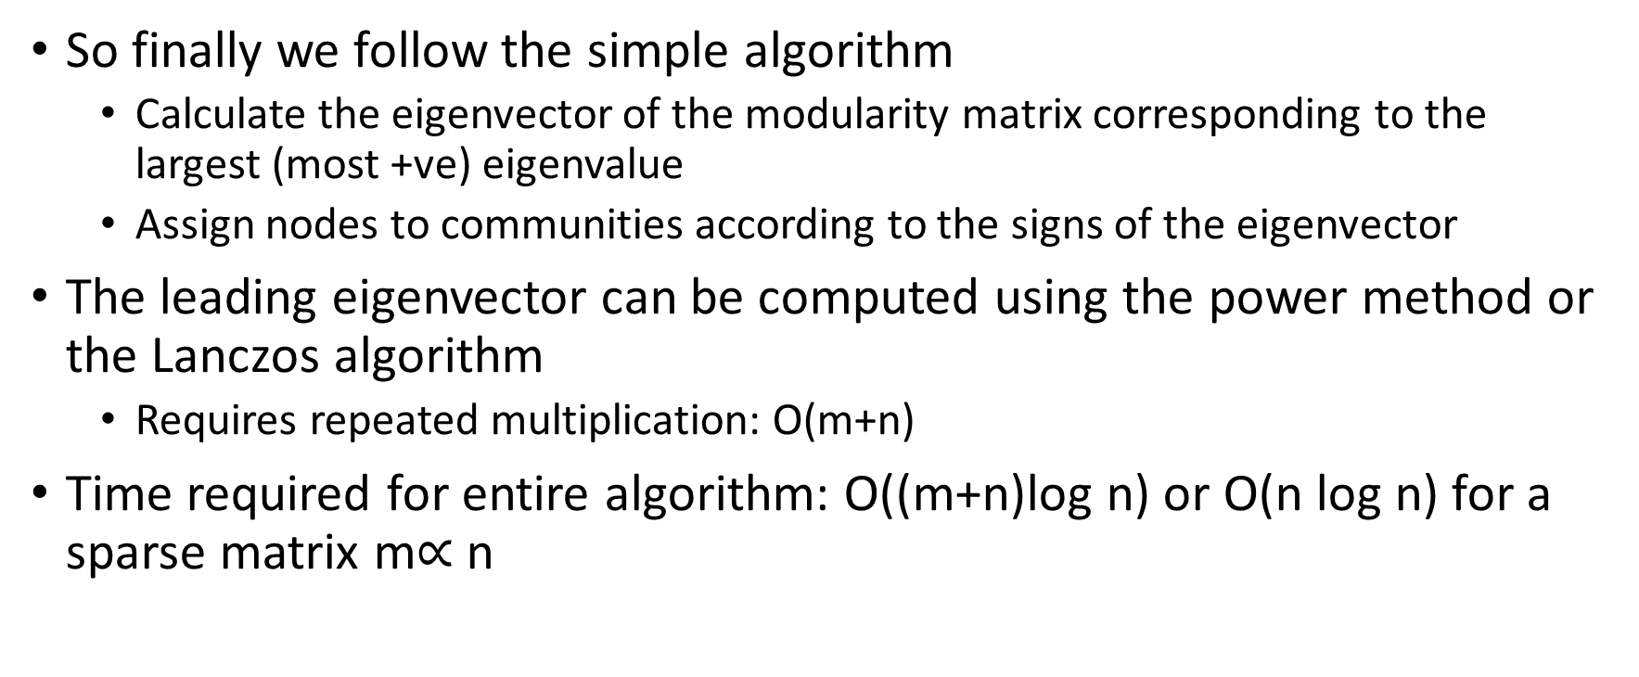
Spectral Modularity Max: conclusion
So finally we follow the simple algorithm
Calculate the eigenvector of the modularity matrix corresponding to the largest (most +ve) eigenvalue
Assign nodes to communities according to the signs of the eigenvector
The leading eigenvector can be computed using the power method or the Lanczos algorithm
Requires repeated multiplication: O(m+n)
Time required for entire algorithm: O((m+n)log n) or O(n log n) for a sparse matrix m$∝$ n

